Slide 1


2026
Briefing Session
10-1-2026

Slide 2

Background Information
Founded on 31st December 2003 to take over accumulated surplus from Hong Kong Junior Chamber Trust Fund Accounts.
A company limited by Guarantee and under IRO section 88.
Article 5(2)
  - To appropriate or apply no more than ninety percent (90%) of the income from investment (dividend from investment, rental and interest income), in a particular calendar year.
  - Granting Project Subsidies on a deficit basis.

Slide 3
Background Information (Cont'd)
Financial year ended: 31st December every year
AGM on/before 30 September every year
Honorary Legal Advisor:
Patrick Wong
Honorary Auditor:
Honorary Auditor : IMCL CPA Limited
(黃龍德會計師事務所有限公司)
Article#12
  No person shall be admitted as a Member unless he is a past national president of JCIHK.

Slide 4
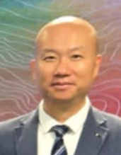
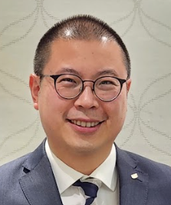
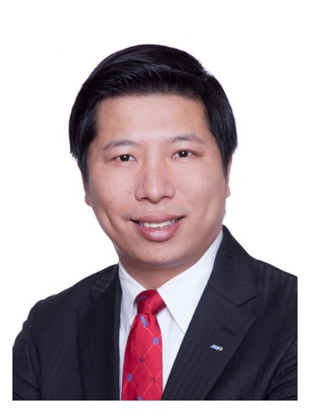
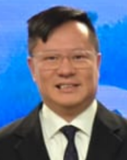
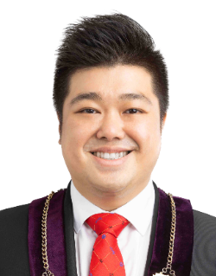
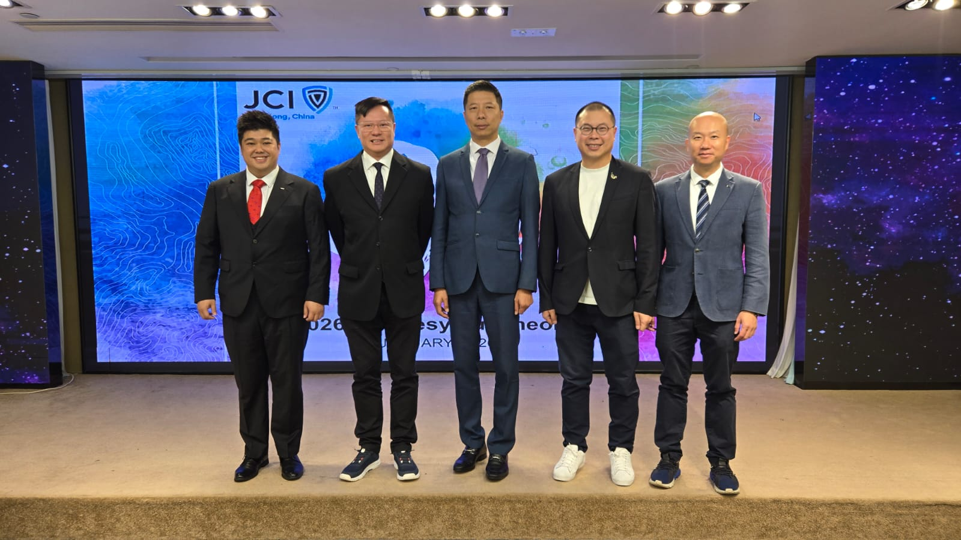
2026-28 Board of Directors
Treasurer
2015 NP Senator
Anthony Leung
Vice Chairman
2012 NP
Senator
Stanley Ng
Chairman
2013 NP Senator
Paul Wu
Secretary
2014 NP
Senator
Johnny Kwan
Ex-officio Director
2026 NP Daryl Lin
Finance
Participation
Administration
  Article #44-47
  – Three years of term of office; can’t serve consecutively for two or more times
  (maximum 6 years of office)

Slide 5
2026 Timetable
Application for grant
  First application due date
  28th February 2026
  Second application due date
  31st May 2026
Reimbursement of 2025 projects report
  submission due date 28th February 2026

Slide 6
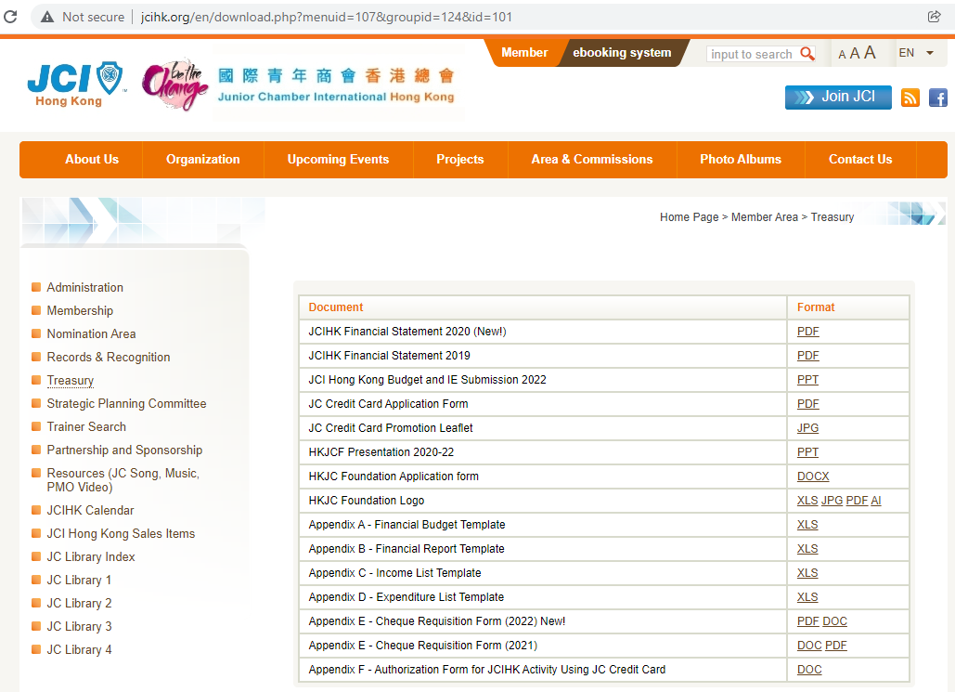
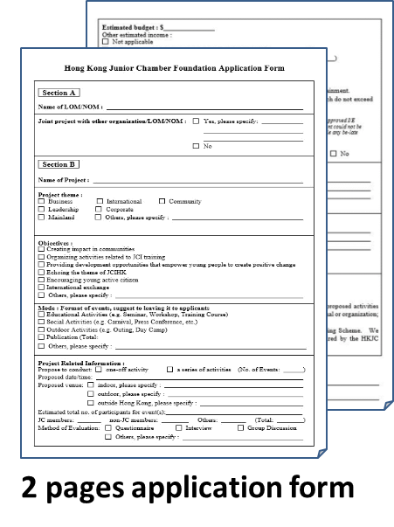
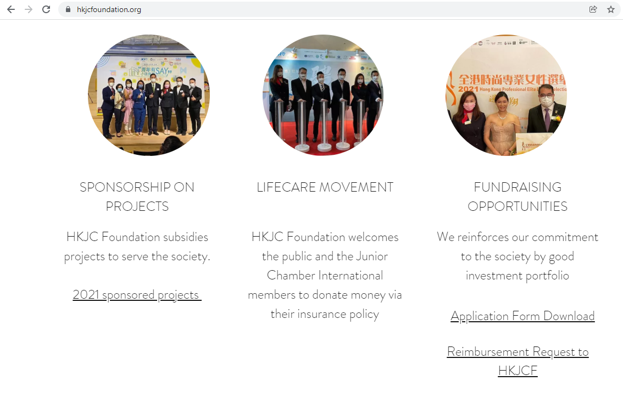
Administration & Application
www.jcihk.org
www.hkjcfoundation.org

Slide 7
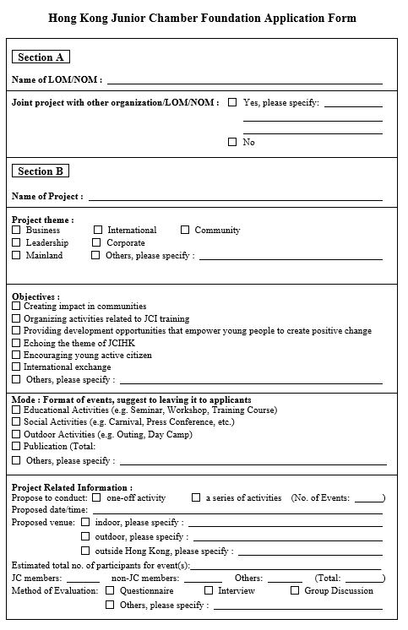
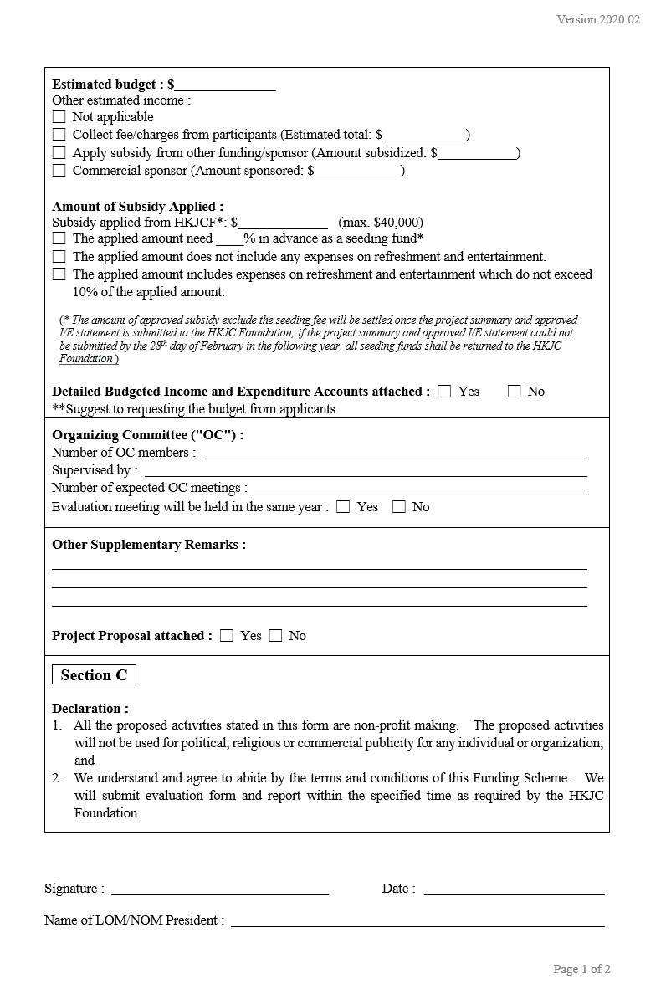
Administration & Application

Slide 8
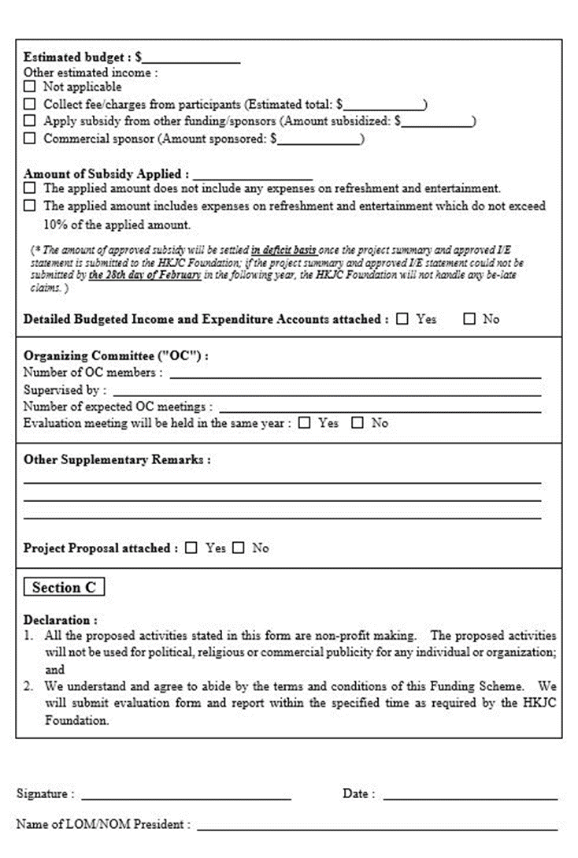
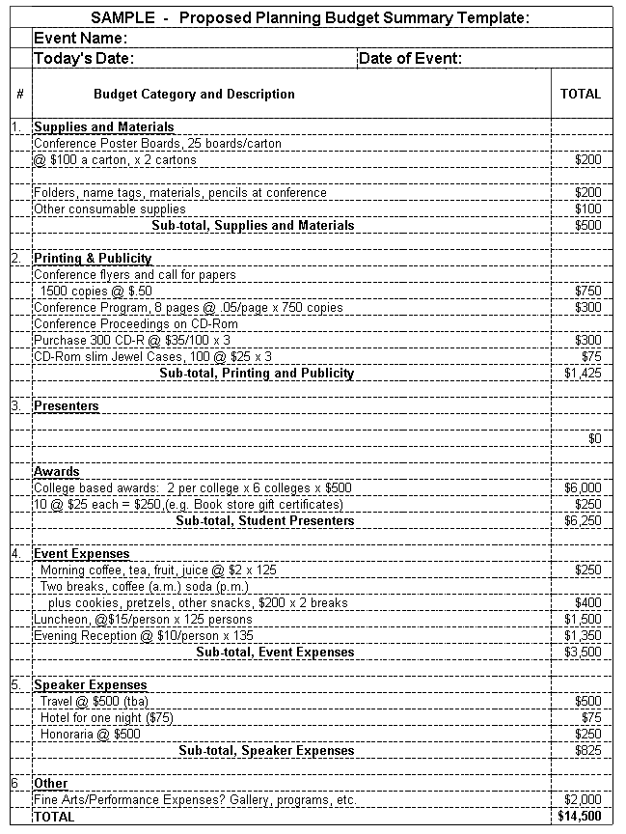


Administration & Application
Project Proposal
  Application Form
  Project Proposal and Budget
2 pages application form
Proposal
Budget
Please submit the application to backend system and email to hkjcfoundation@gmail.com. Hardcopy is not necessary.
Application results will be sent to the applicants via email in March / June

Slide 9


Participation & Promotion
Use of HKJC Foundation logo to promote funded project/event
Proper Invitation and protocol is expected by the Foundation board
Please send event invitation to Vice Chairman Senator Stanley NG as early as possible via:
93105401 hkjcfoundation@gmail.com
Actively join/participate in the project/event funded by HKJC Foundation
To improve communication and as reference to our granting process

Slide 10
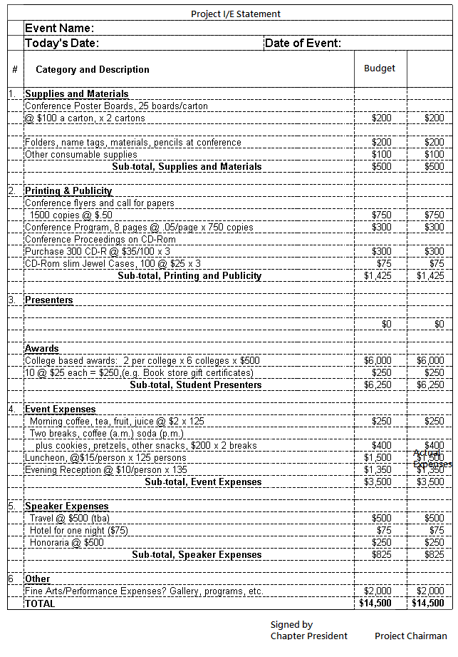
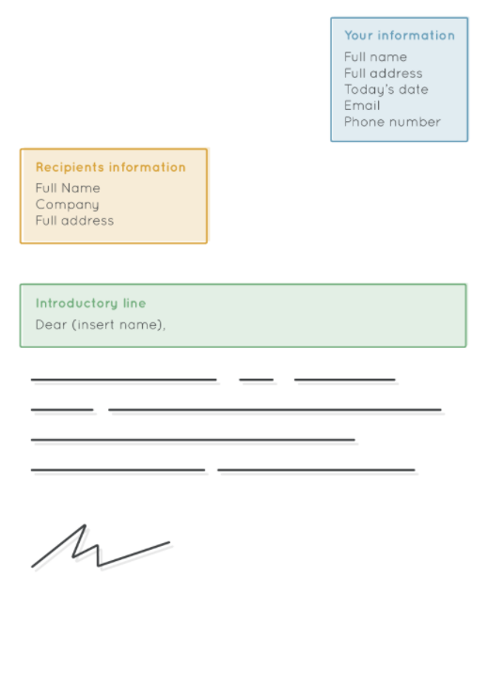




Treasury & Finance
Cover letter + Report with I/E accounts and project photo (2-3 pages pdf)
Brief Report
on outcome
(e.g. number of participants,
photos, list of sponsors & supporting organizations etc.)
Cover letter: address to HKJCF Chairman and Treasurer
Brief report on outcome (e.g. number of participants, photos, list of sponsors & supporting organizations etc.)
Project title in the Reimbursement Request must bear the same title used in the application.
Early submission will have earlier reimbursement.
Foundation reserves the rights to discount the reimbursement amount for any discrepancy or improper protocol.
Late application will not be entertained.

Slide 11
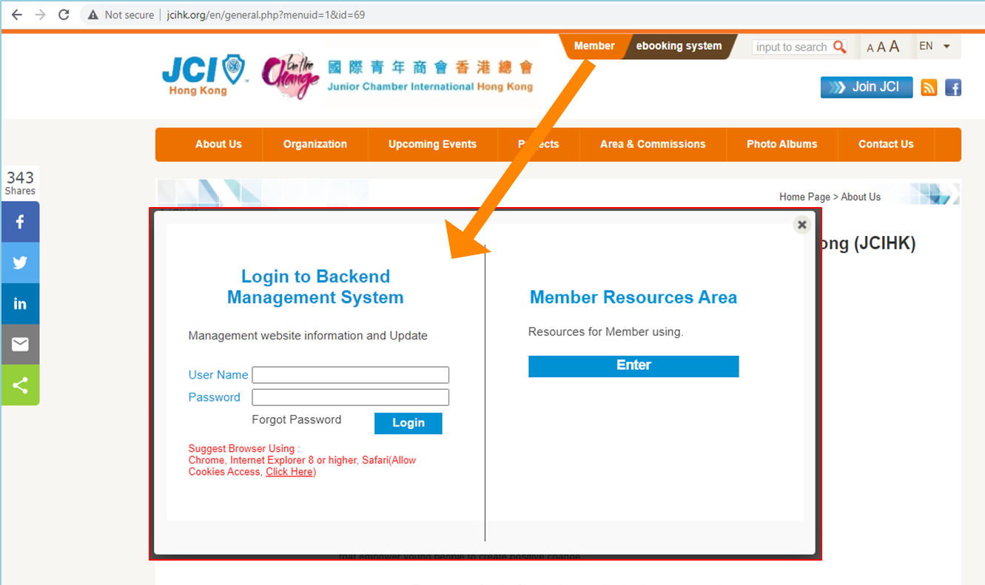

Treasury & Finance
Reimbursement Request should be made before 28 Feb 2026
Softcopy only: submit via Backend System & email to hkjcfoundation@gmail.com
Direct deposit to applicant’s bank account if reimbursement is approved

Slide 12
Reimbursement Request to HKJCF
Submission Procedures
For those who have applied HKJCF funding, please follow the below procedures for reimbursement:
1) Prepare cover letter to HKJCF members (pls refer to note 1)
- cover letter should be: (a) duly signed by the LOM President (NOM:
Supervising Officers) with the claim amount specified (shall not over the approved amount) and cheque payable (i.e. account name of the LOM/NOM)
2) Prepare brief report on project outcome with some photos
3) Attach adopted financial report (I/E) for the project, with proper
signatures of the project treasurer, project chairman and LOM treasurer or
project supervising officer (as appropriate)
4) Prepare Form of Acknowledgement to HKJCF
For (1) to (4) called as "Reimbursement Request"
5) Submit electronic copies of the Reimbursement Request (1 PDF file) via
JCIHK's website "Backend Management System" to all HKJCF Board
Members
6) Deposit the original hard copy to Chamber Office's HKJCF mail box
(attention: HKJCF). The envelope should be marked as (Re:HKJCF - Mark
Your LOM name: Project Name)
Few things you have to take note:
1) Cover letter - please address to HKJCF Chairman Senator Eric Tang and Treasurer Senator Stanley Ng
2) Brief report on project outcome (e.g. number of participants, photos,
supporting organizations name etc)
3) Project title in the Reimbursement Request must bear the same title used in your application
4) Late application will not be entertained.
All LOMs should submit their Reimbursement Request, Brief report and adopted I/E via Backend System (softcopy) and email to hkjcfoundation@gmail.com before 28 Feb 2025. We do not allow late submission.
www.hkjcfoundation.org
Reimbursement
Request to HKJCF

Slide 13
THANK YOU!

