Slide 1
E-Bid Book Seminar II
14 Jul 14
JCIHK Office
Eric Lin
JCI Lion Rock

Slide 2

Bid book Formula
Strategy
Right Category
Story
Unique & New
Presentation
Concise & Impactful

Slide 3
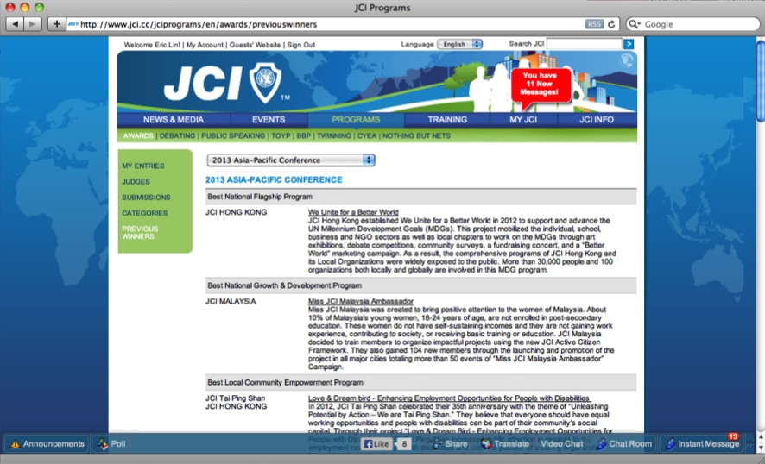
http://www.jci.cc/jciprograms/en/awards/previouswinners

Slide 4

Story . Unique & New
Know the Criteria & Your Selling Point
Uniqueness & Newness in …
Social Impact (~social issues)
Beneficiaries
Partnership
Program Design
Scale
Advertising
Participation
Can you call out 2-3 Points for your projects?
Notes:
Help you differentiate … as ppl naturally give better score if they see some new insight.

Slide 6
New System – Each Criteria has set “Detail Questions” + Word Limit (100-200)
﹪ | Criteria | Mandatory Question
15﹣30﹪ | Community Impact | How did the Local Organization measure community impact for this program? Describe the actual community impact produced by this project.
15﹣20﹪ | Long-term Impact of the Program | What is the expected long-term impact of this project? What changes would you make to improve the results of this project?
15﹣20﹪ | Objectives, Planning, Finance, Execution | What were the objectives of this program? How does this program align to the JCI Plan of Action? How does this project advance the JCI Mission and Vision?
10﹣15﹪ | Member Participations | By number, how many members were involved in this program? By percentage, how many members of the Local Organization were involved in this program? Describe the main roles of the participating members in this program
10﹪ | Impact on Local Organization | How did the Local Organization benefit from running this project? How did the program advance the JCI Mission? How did the project advance the JCI Vision?

Slide 7
New Criteria – Award Specific
Account for ~20-40% of Score
Awards | Specific Criteria
Best Publication | Appearance, Layout, Circulation, Coverage
E-Marketing | Creativity & marketing effectiveness
Best Economic Development | Promotion of Free Enterprise
Personal Skill Development | Skills Developed
Inter-organization collaboration | Cooperation between LOMs
Growth & Development | Method of Implementation
UNMDG | Link with UN Agencies or Partnership
CSR | Alignment to UN Global Compact Principles
World Peace | Cooperation for the Sake of World Peace

Slide 8
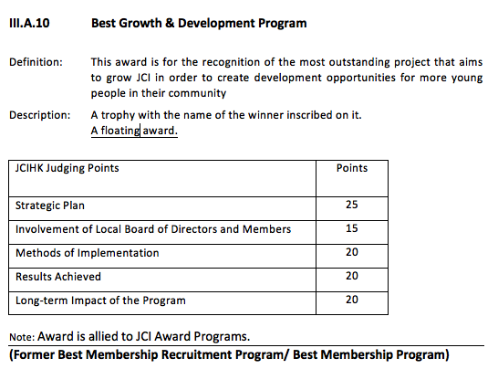
Case: Member Growth & Development
2013 ASPAC Winner
Story:
REFORM = REcruitment + FOllow through + Retention + Mentorship
Integration
Elite Mentorship Program
Leader Seminars
Basic:
Growth
Fellowship
Notes:
Program

Slide 9

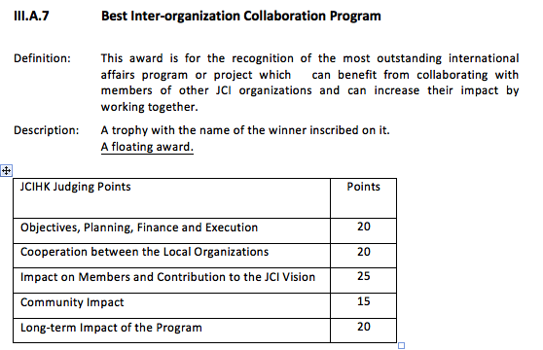
Case: Inter-organization Collaboration
Story: 1st in LOM History with “Japan + HK” parties join support
Elevation
Unique:
“Japan + HK” Collaboration on LOMs, Media, Govt, Schools
Basic:
Program
Participation
Notes:
Uniqueness on

Slide 10

COM in NC 2012
3 Finalists in 2012 World Congress
3 Finalists in 2013 ASPAC

Slide 11
Present Concisely with Impact
Writing
Know the Criteria, Questions & Word limit
Easy to Understand
  Simple English
  Point Form
  Formatting: HTML
Convincing
  Data & measurement
  Endorsement: Name, Title, Words
  Media Reporting
Visual
4 Pictures only
Easy to Understand
  Standard Template
  Header + Key point consistent with writing
Convincing
  Chart/Graph esp compare
  Pictures to show important ppl, media coverage etc
  Social Impact Pictures

Slide 12
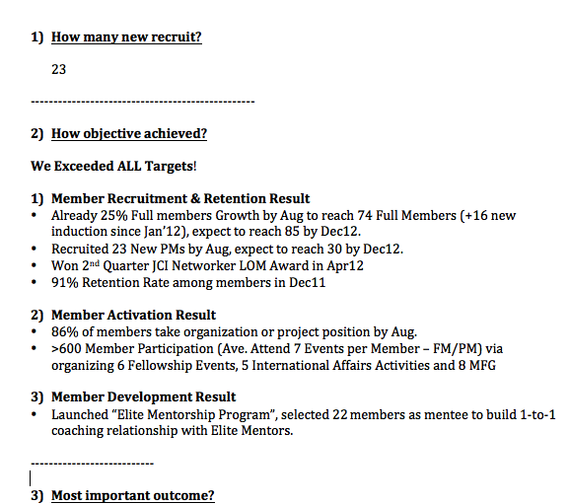
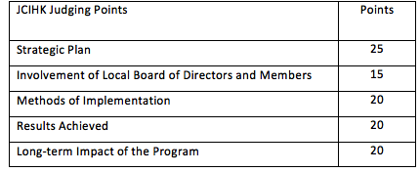
Case 1: Best Growth & Development

Slide 13
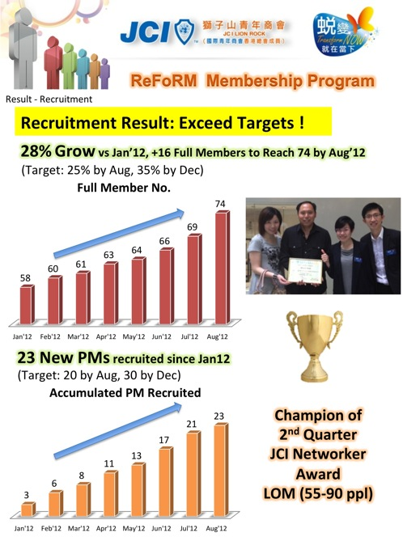
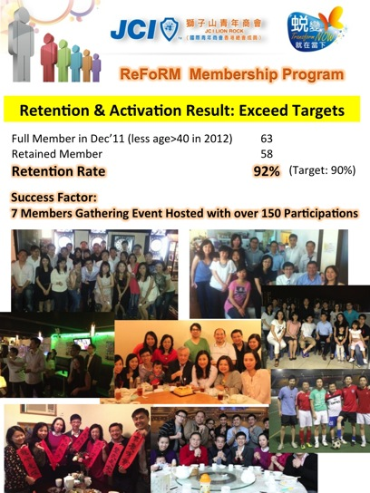

Slide 14
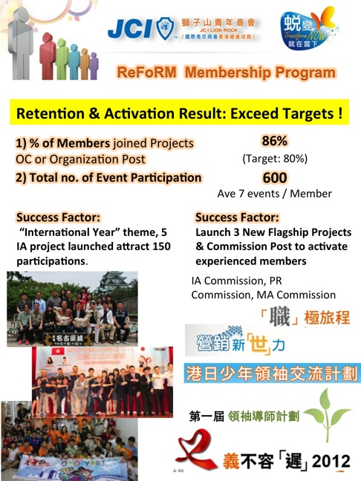
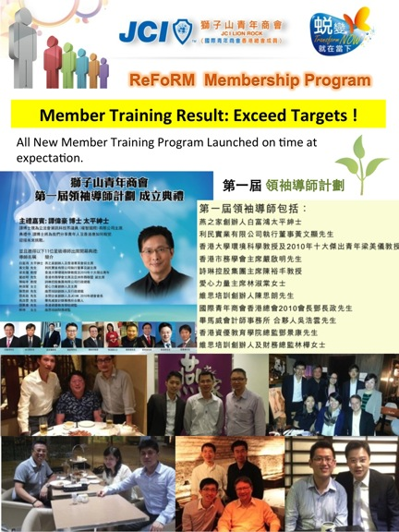

Slide 15
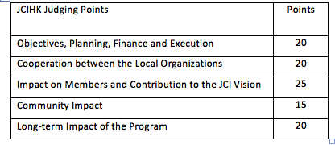

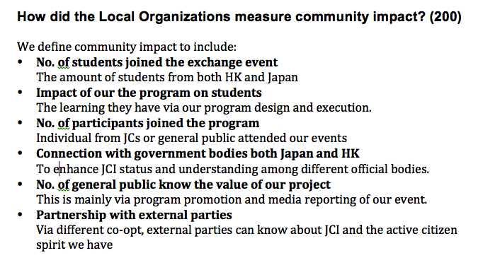
Case 2: Best Inter-organization Collaboration
Define your criteria

Slide 16
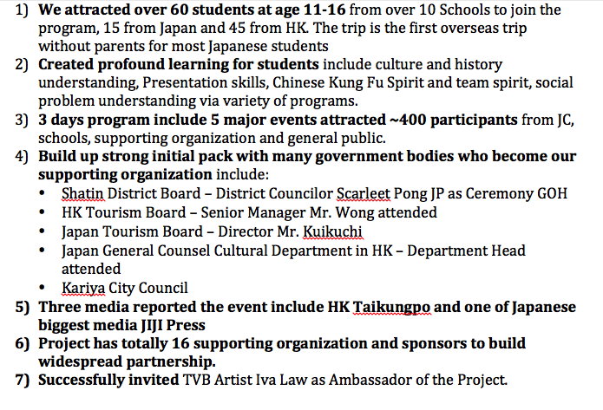
Case 2: Best Inter-organization Collaboration
Self Assess

Slide 17
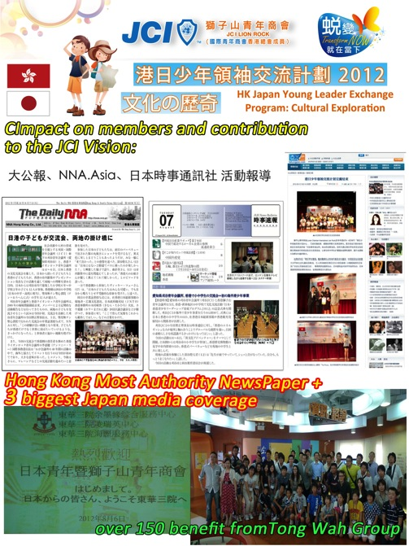
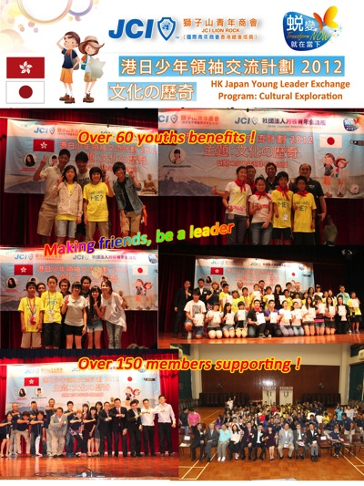

Slide 18
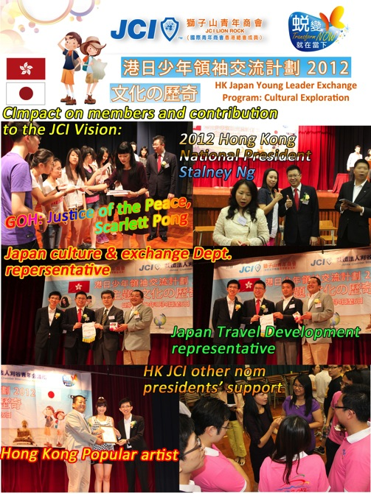
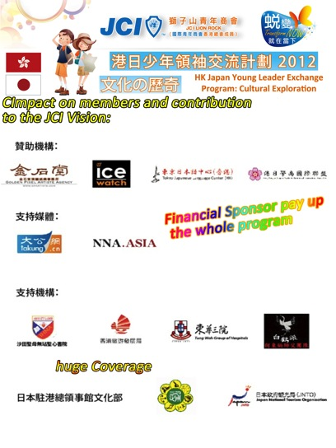

Slide 19
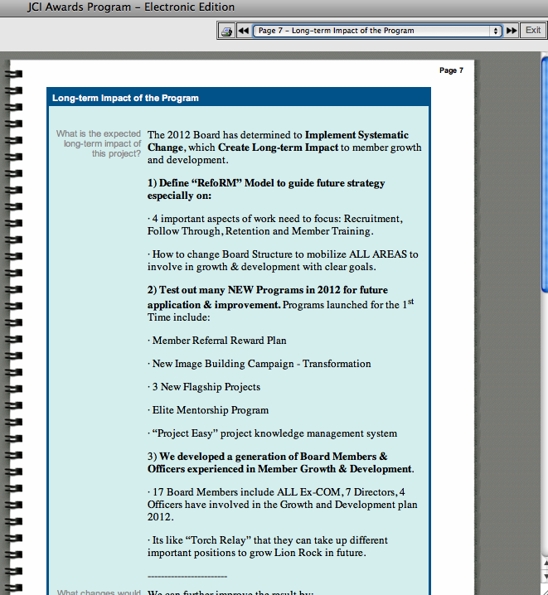
To see any Format in bidbook system i.e. Point Form, Bold, Space etc.
You need convert “Word” to “HTML”

Slide 20
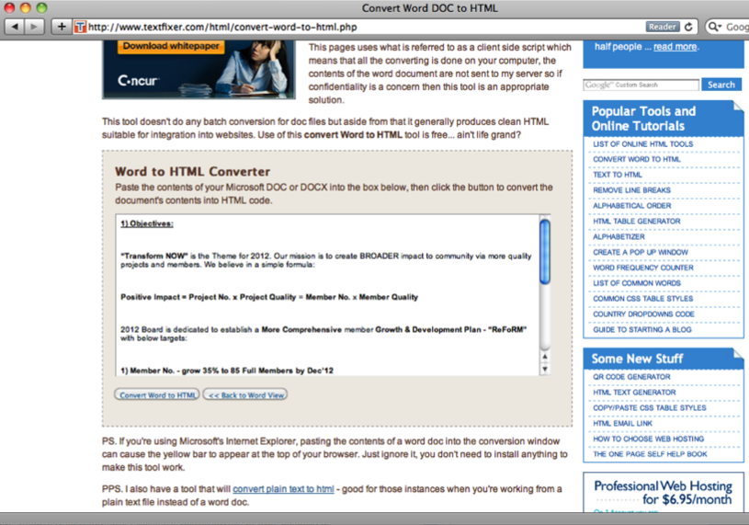
www.textfixer.com/html/convert-word-to-html.php
Free Website Application
Copy & Paste formatted “word” essay to the Window
Click “Convert Word to HTML”

Slide 21
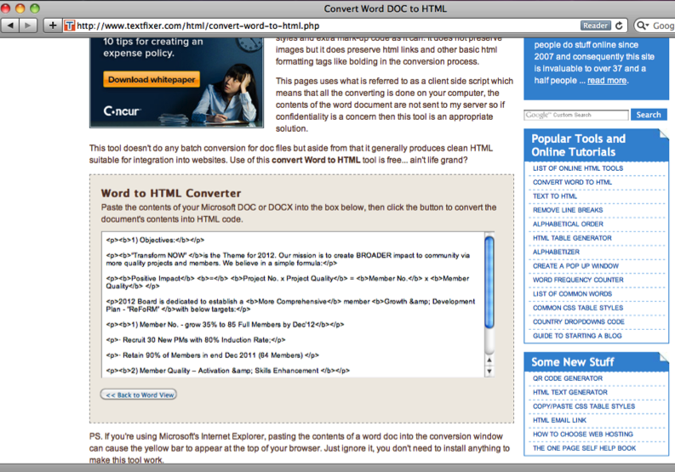
Free Website Application
www.textfixer.com/html/convert-word-to-html.php
3) Copy & Paste HTML essay to the Bidbook upload page box

Slide 22
End

